Slide 1
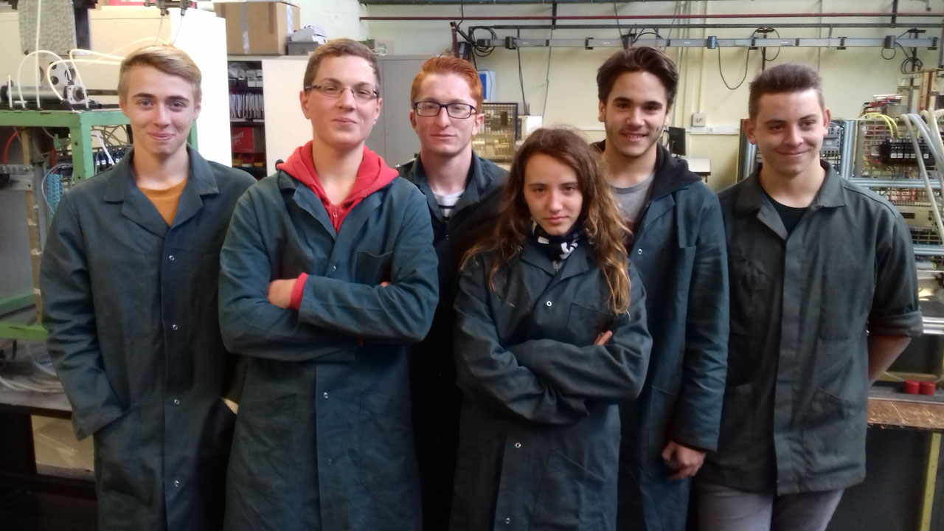

Slide 2
Maintenance Self-entrepreneur Challenge
Setting up an industrial equipment maintenance business
Of self-employed technicians thanks to a virtual platform

Slide 3
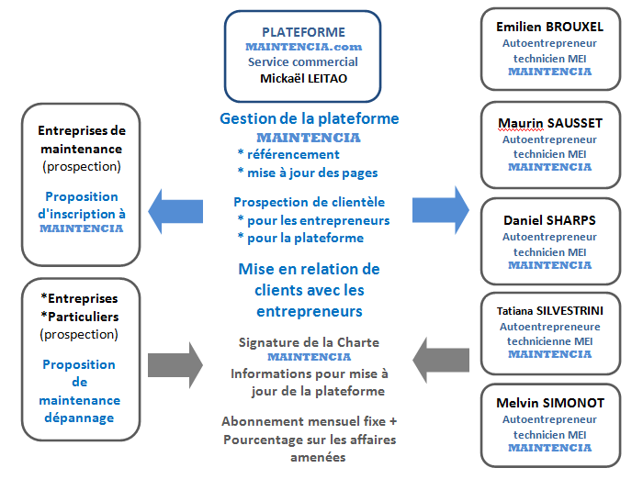
MAINTENCIA

Slide 4
MAINTENCIA Price List
Website Management
Registration on the platform Commercial Prospection | €80 / month
+ referral fees
From 100 to €300 VAT included | 5% | From €5 to €15
From 301 to €600 VAT included | 8% | From €25 to €48
From €601 VAT included | 10% | From €60

Slide 5
Applicable hourly rates MAINTENCIA
Mechanics | Rate 1 | Rate 2 | Rate 3 | Rate 4
Assembly - disassembly -exchange Milling – Manufacturing | €36
Electricity
Assembly / standard exchange |  | €42
adjustment – diagnosis |  |  | €50
Hydraulics
Assembly - Disassembly |  | €42
Installing - exchange |  |  | €50
Adjustment- diagnosis – study |  |  |  | €65

Slide 6
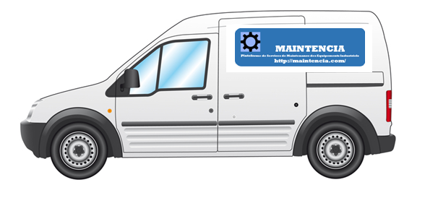
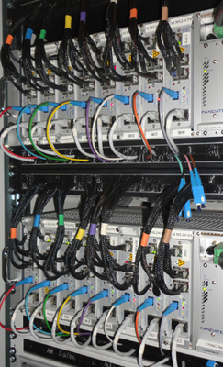
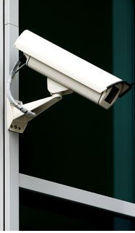
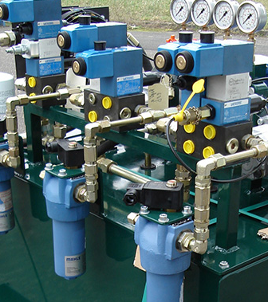
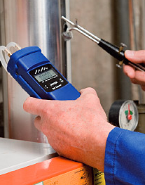
Our MAINTENCIA technicians quickly present in your company

Slide 7
Georges Cabanis High School
Brive-la-Gaillarde
New-Aquitaine Region
France
Destination Entreprise
Challenge project 2017
Emilien BROUXEL
Mickaël LEITAO
Maurin SAUSSET
Daniel SHARPS
Tatiana SILVESTRINI
Melvin SIMONOT
Elèves Techniciens
de Maintenance des Équipements Industriels
(Advanced level class - MEI)

